Slide 1
Examples of Text Types
…

Slide 2
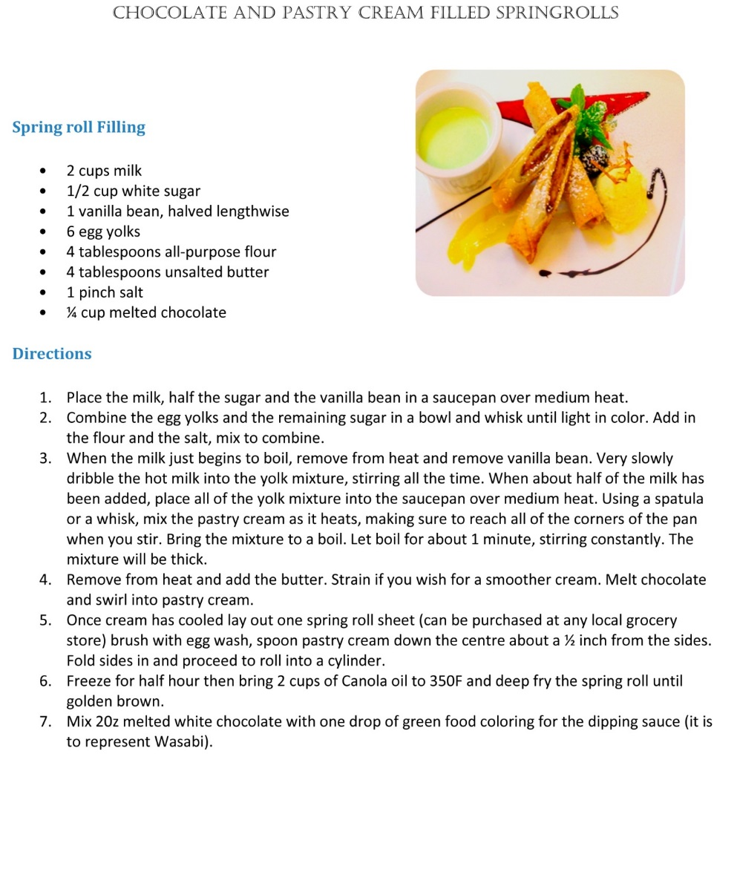
Notes:
(recipe)

Slide 3
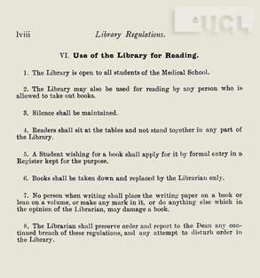
Notes:
(library regulations)

Slide 4
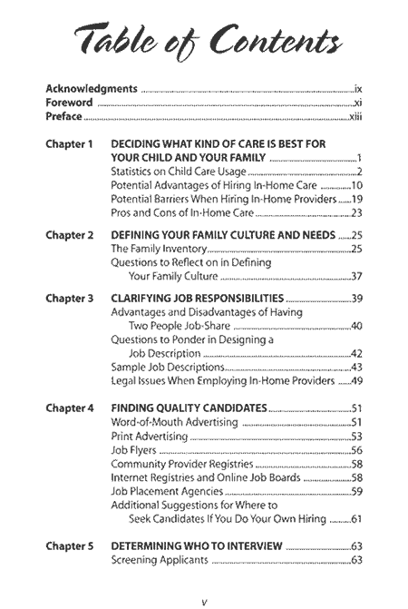
Notes:
(table fo contents)

Slide 5
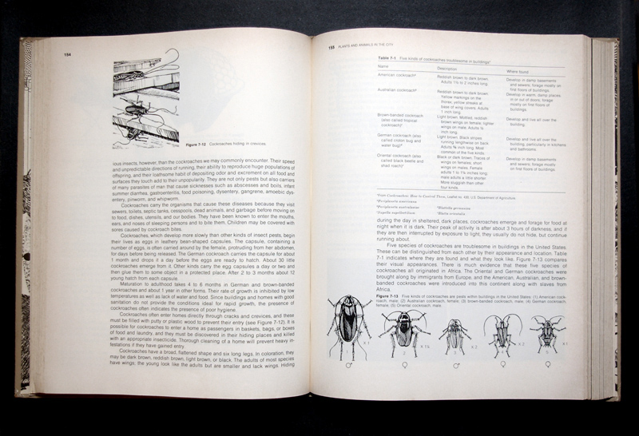
Notes:
(biology textbook page)

Slide 6
Notes:
Within the broad area of newspaper articles, we have different sub-genres. This is a news report.

Slide 7
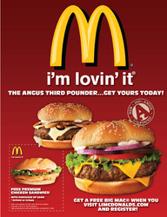
Notes:
Reading strategy: Look for what is being advertised. A higher level of reading: What advertising techniques are being used? (I’m lovin’ it)

Slide 8
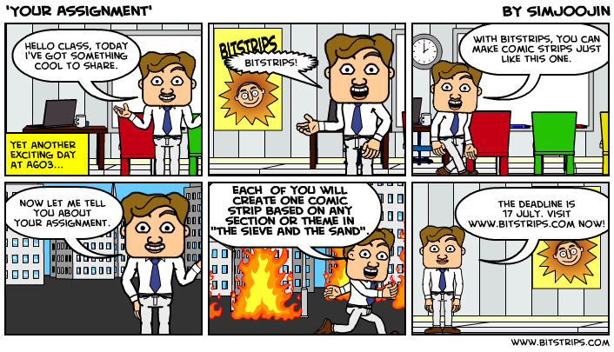
Notes:
Comic Strip: basic: not 6 unrelated pictures put together – know the sequence; comic strips usually funny – look for humour

Slide 9
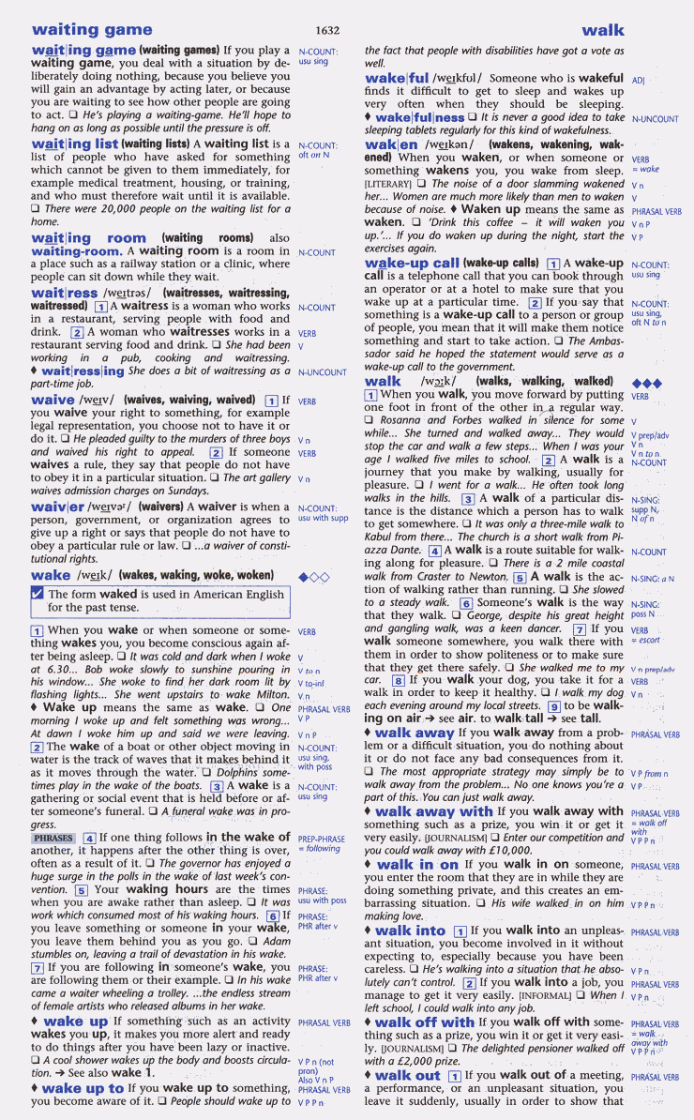
Notes:
Dictionary: a lot of skills involved, such as finding the right headword; understanding the abbreviations; understanding how derivative usages are organised; the format

Slide 10
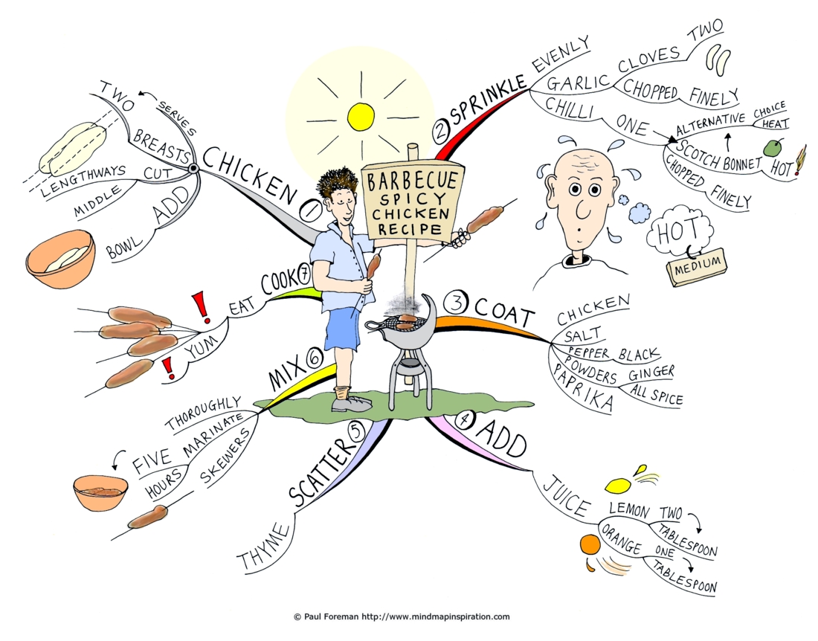
Notes:
Mind map: how the main concept is developed through the branches, which are examples

Slide 11
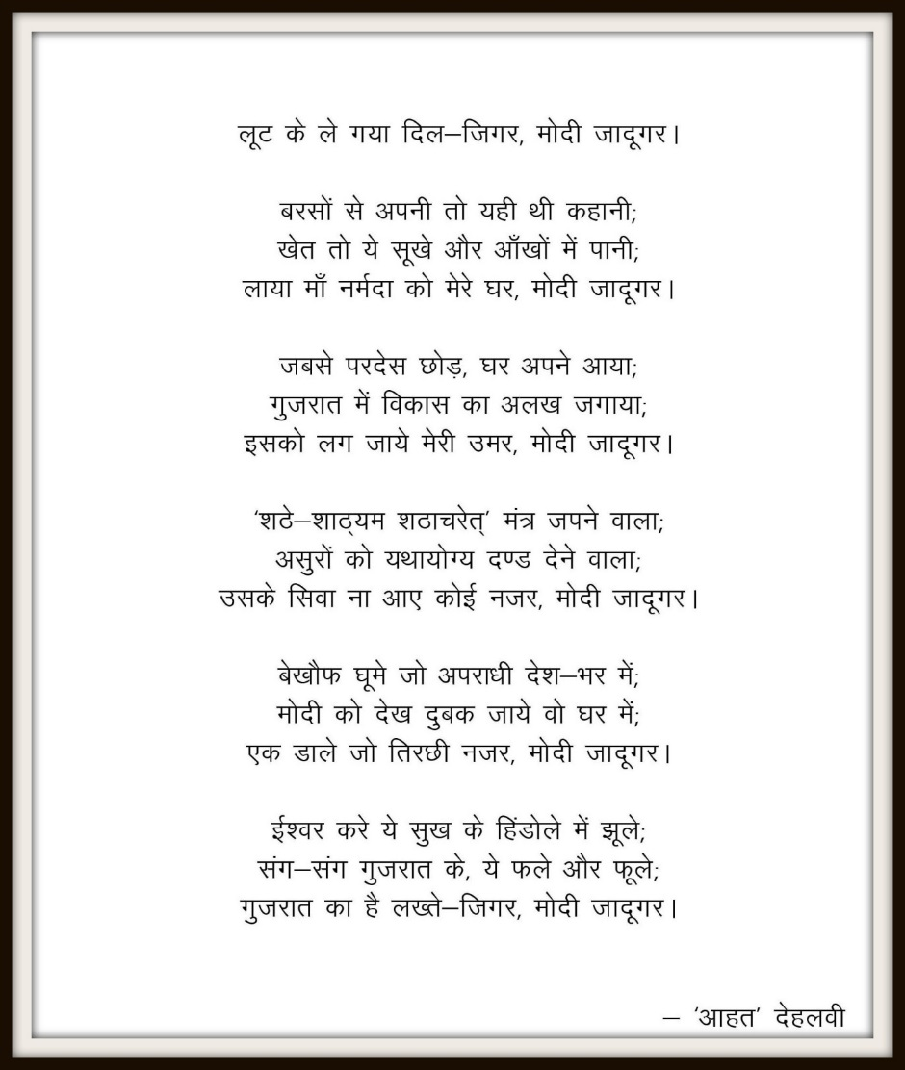
Notes:
Poem: eg, rhyming; figurative language; images

